Slide 1

Team Name : AiCrew
Team Leader Name : A Bhargavi
Problem Statement : AI-Powered Marketplace Assistant for Local Artisans

Slide 2
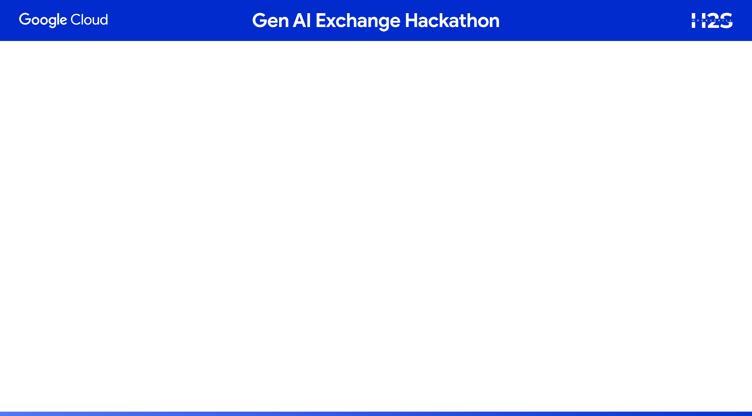
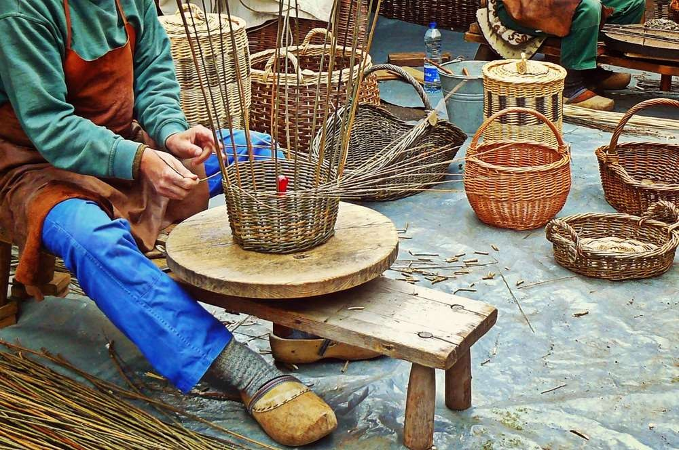
Problem Statement through Field Research
The Ground Reality – Local Shops
Artisans are still 👀invisible online, relying mostly on local fairs and word-of-mouth.
💸Middlemen take away most profits, leaving artisans with only 20-30% of the value.
Many artisans lack digital marketing and ☎
storytelling skills, so their heritage is lost.
There is strong🌍global demand for authentic crafts, but no bridge to connect artisans with these markets.
“We create with our hands and heart, but still stay unseen beyond our village. Middlemen take our profits, while our stories and struggles go unheard.” ~Local artisan

Slide 3
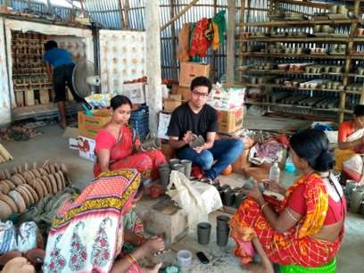
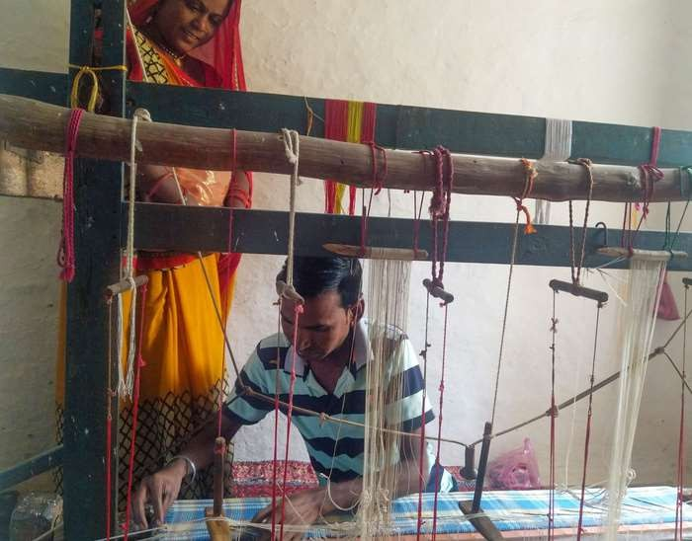

I want authentic, sustainable, handmade products.
A partnership where craft meets creativity, and tradition meets innovation.
I Create, but no one hears my story.

Slide 4
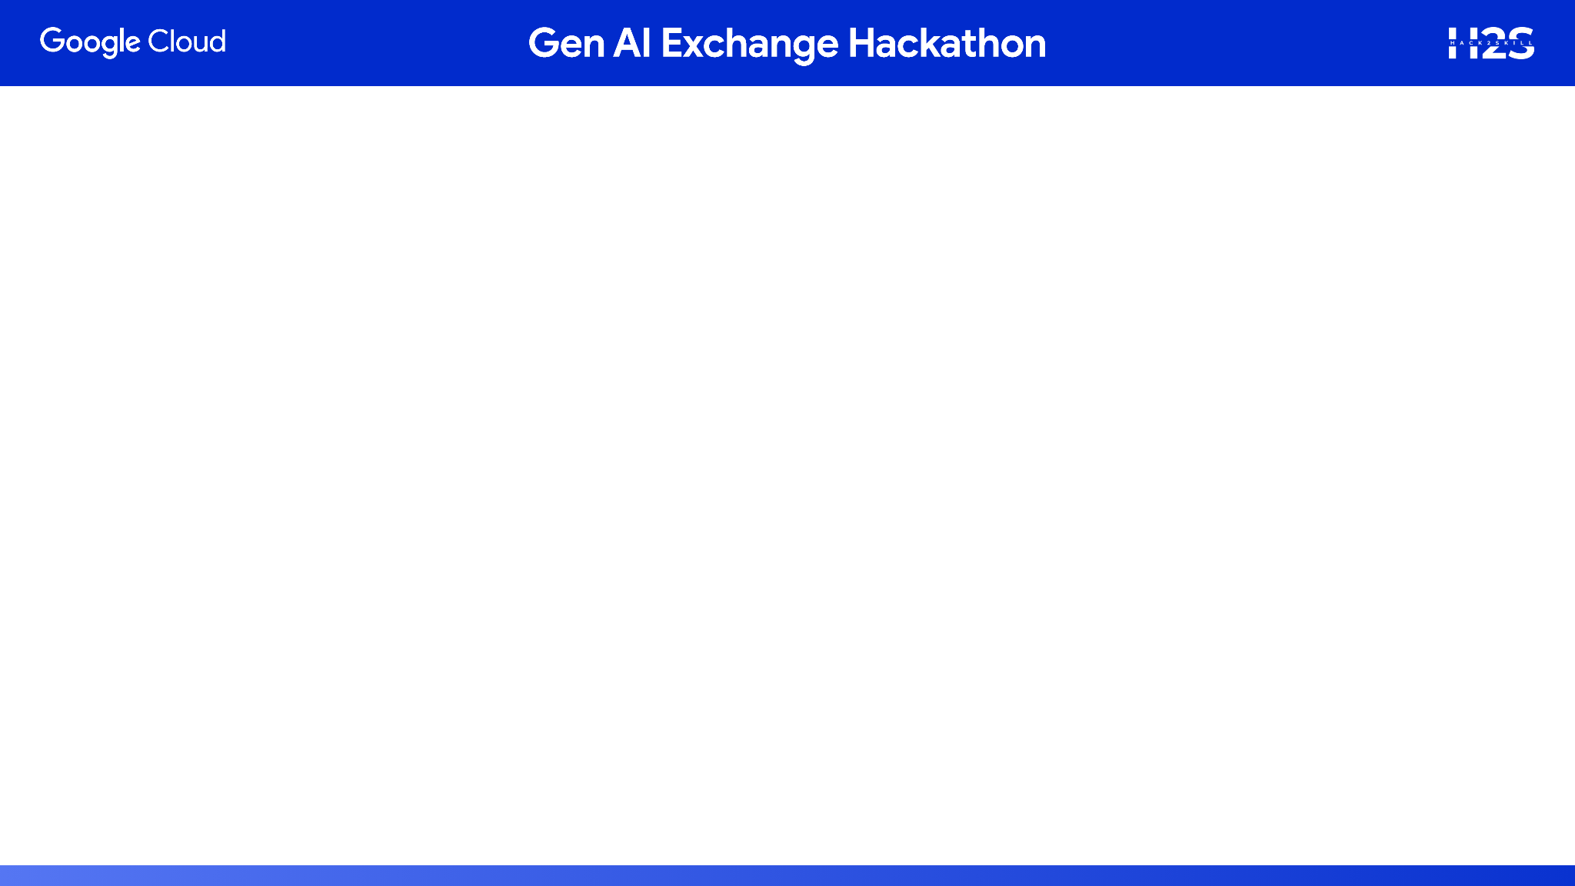


ArtEcho is not just another online marketplace.
It is a digital partner for artisans – giving them tool, voice, and visibility.
Core Idea
Empower artisans to tell their stories through AI-generated narratives and audio.
Connect them directly with buyers and designers worldwide.
Key promise

Slide 5
How different is it from any of the other existing ideas
Where artisans are today..
Etsy / Amazon Handmade
They are marketplaces, not partners.
Focus is on selling products
only, not on storytelling or artisans’ empowerment.
NGO / Handicraft Portals (like CCIC or Crafts Council
Often limited, small scale, and lack of AI-driven features.
No matchmaking, no catalog automation, little global visibility.

Slide 6
What makes ArtEcho Unique
✨ Story-First Platform
Every product is paired with a Story Card – buyers connect emotionally.
AI Brand Matchmaker
Designers share their styles, AI suggests matching artisans – real Collaboration.
🌍Global Supply Chain Bridge
Auto-generated export-ready catalogs
Digital Partner, Not Just Marketplace
Tools for storytelling, cataloging, discovery, and AI-powered growth

Slide 7
How will it be able to solve the problem?
Invisibility -> Digital voice
Problem : artisans remain unseen beyond local
fairs.
Solution: ArtEcho gives every artisan a digital profile with story, images, and audio to showcase globally.
Middlemen Exploitation -> Direct-to- Buyer/Designer Access
Problem: Middlemen take away 70–80% of value. Solution: Buyers and designers connect directly with artisans for purchases and collaborations.
Lack of Storytelling → AI Story Cards Problem: Artisans struggle to market their craft. Solution: AI auto-generates story cards and audio, turning products into emotional stories that buyers value.
Digital Divide → Simple, Multilingual Tools Problem: Artisans are rural, non-English speakers.
Solution: ArtEcho provides multilingual interfaces and AI translation, making global communication effortless.
Missed Global Demand → Export-Ready
Catalogs
Problem: No scalable bridge to global markets.
Solution: Auto-generated export-ready catalogs.

Slide 8
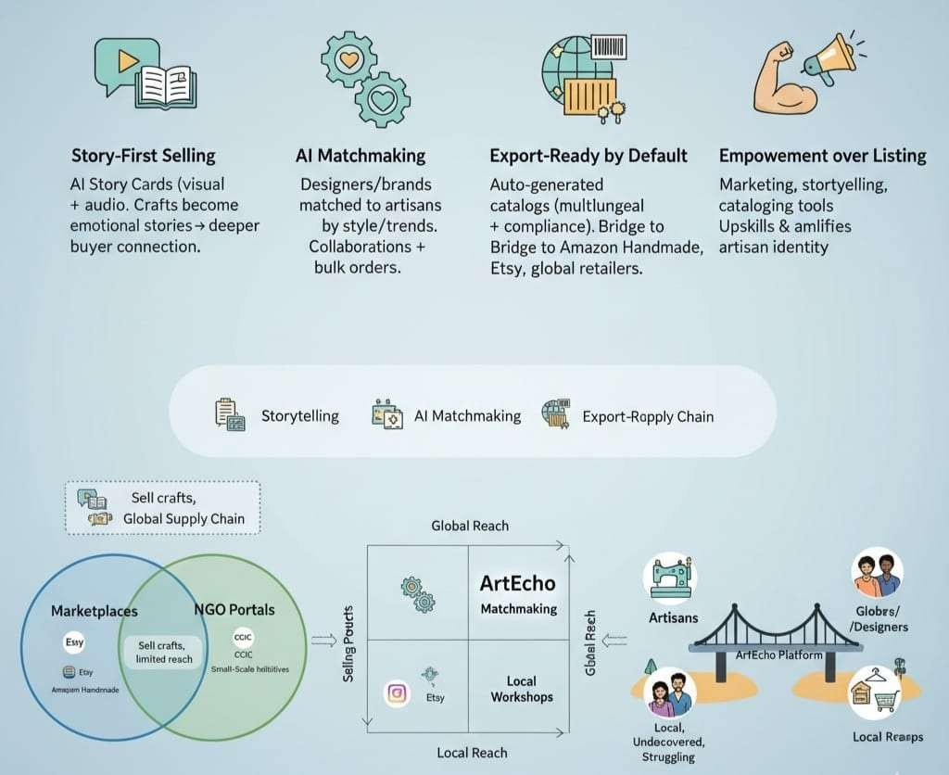
USP of the proposed solution
“More than a marketplace — a
digital growth
partner for artisans.”

Slide 9
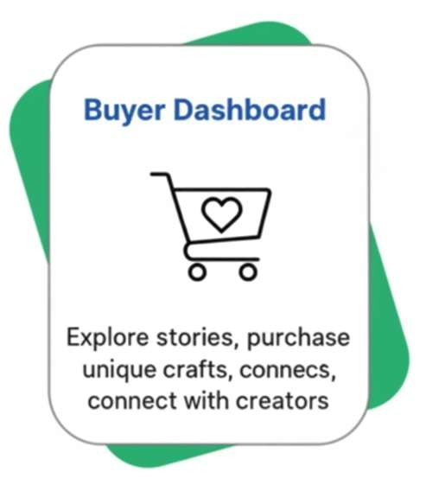
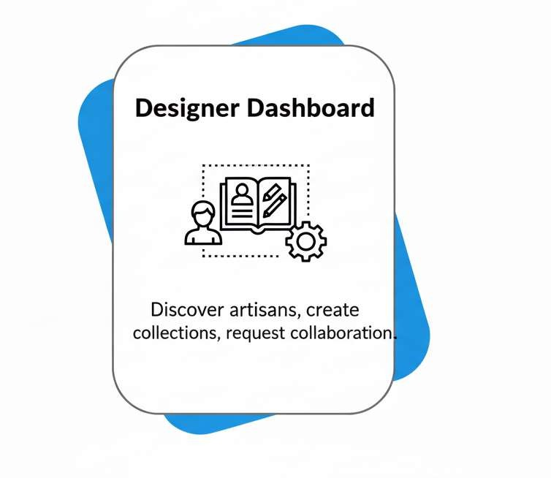
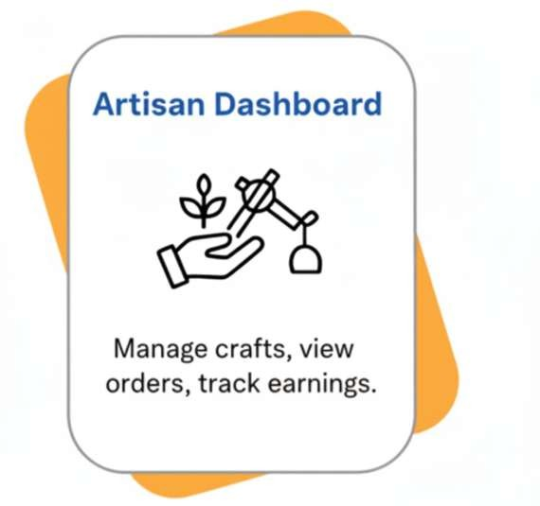
List of features offered by the solution

Slide 10
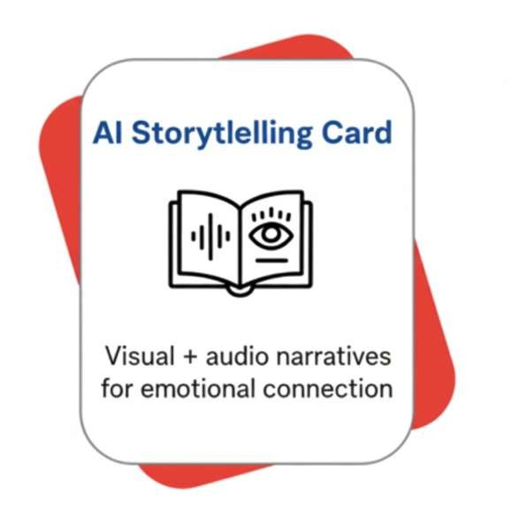
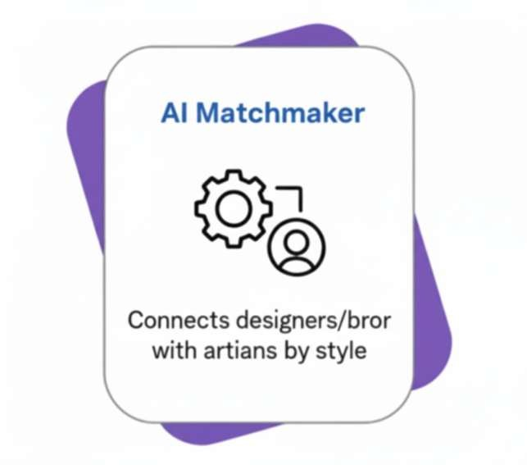
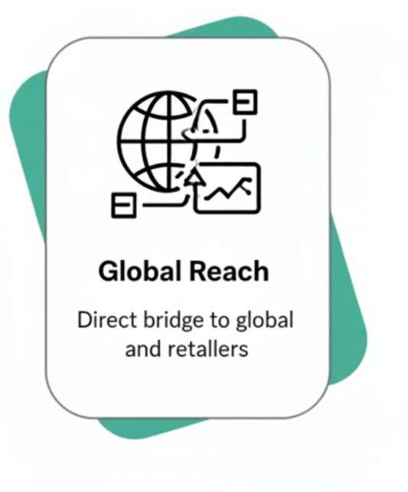

Slide 11
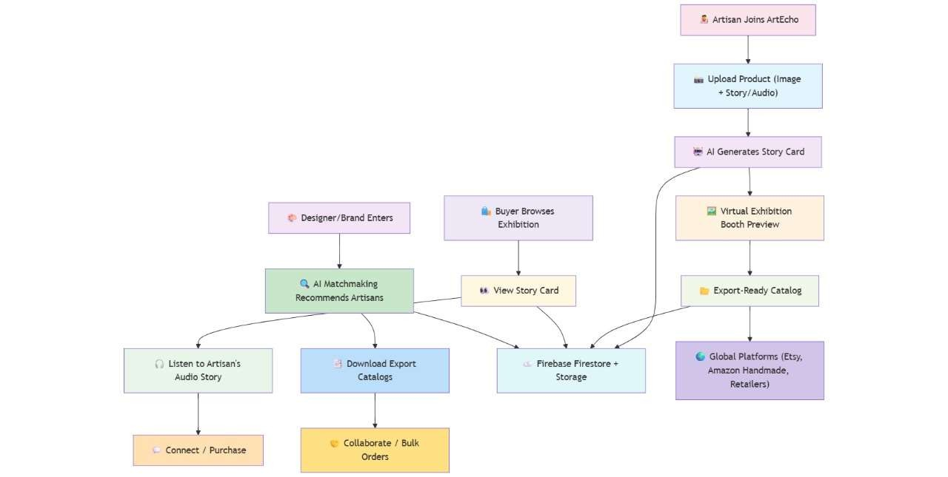
Process flow diagram or use-case diagram

Slide 12
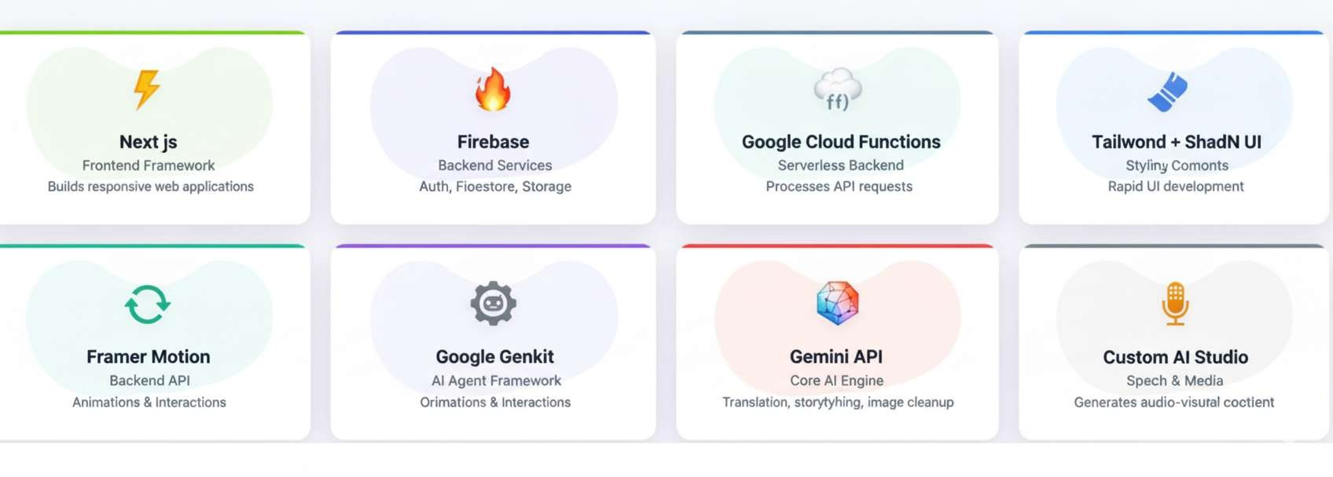
Technologies to be used in the solution

Slide 13
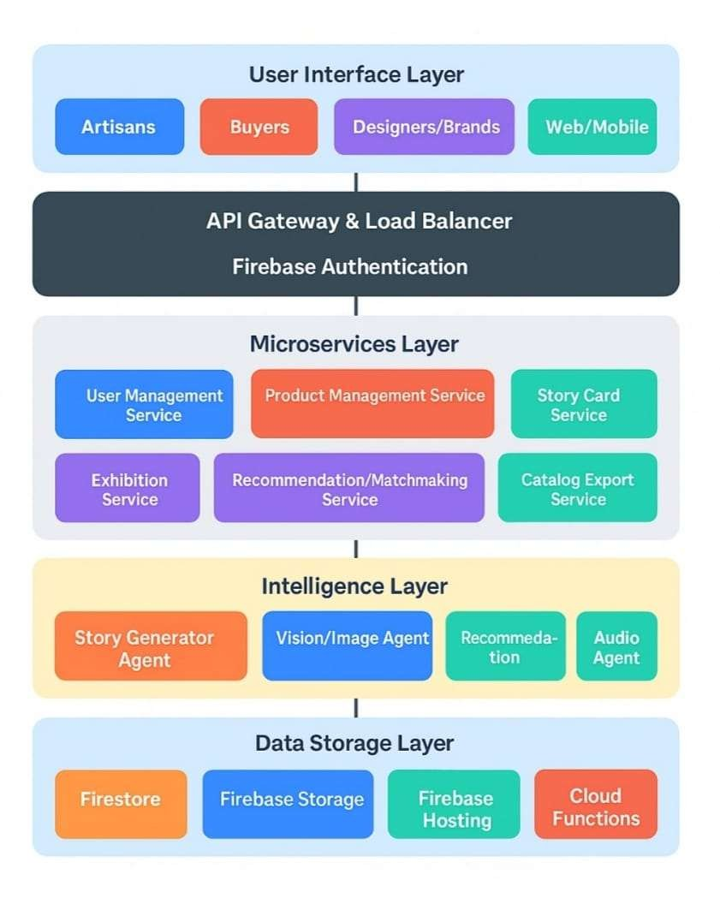
Architecture diagram of the proposed solution

Slide 14
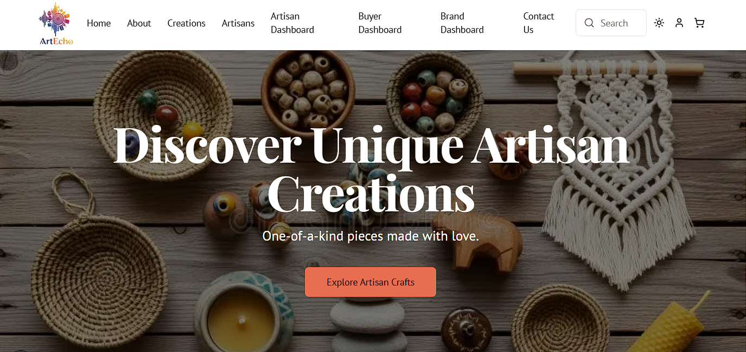
Mock diagrams of the proposed solution

Slide 15
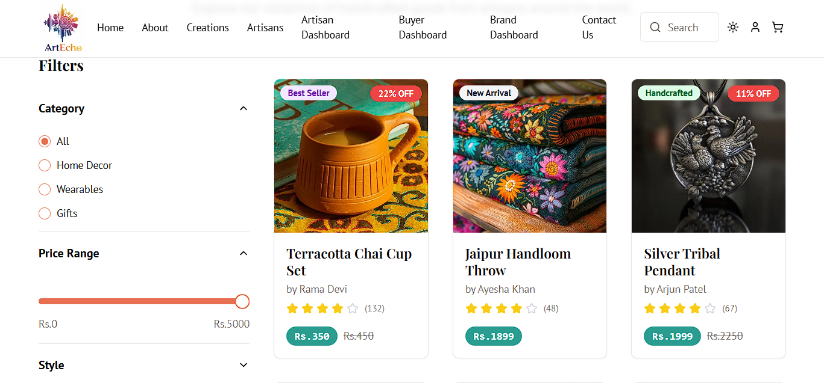


Slide 16
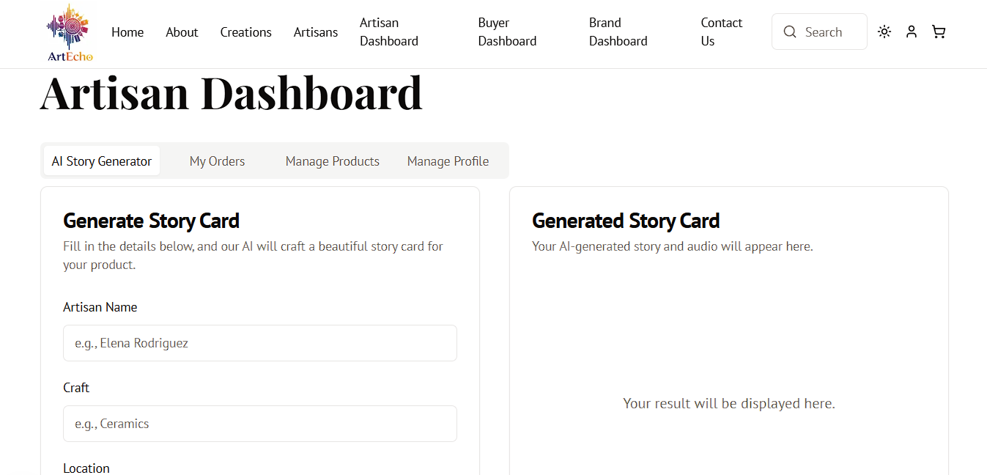

Slide 17
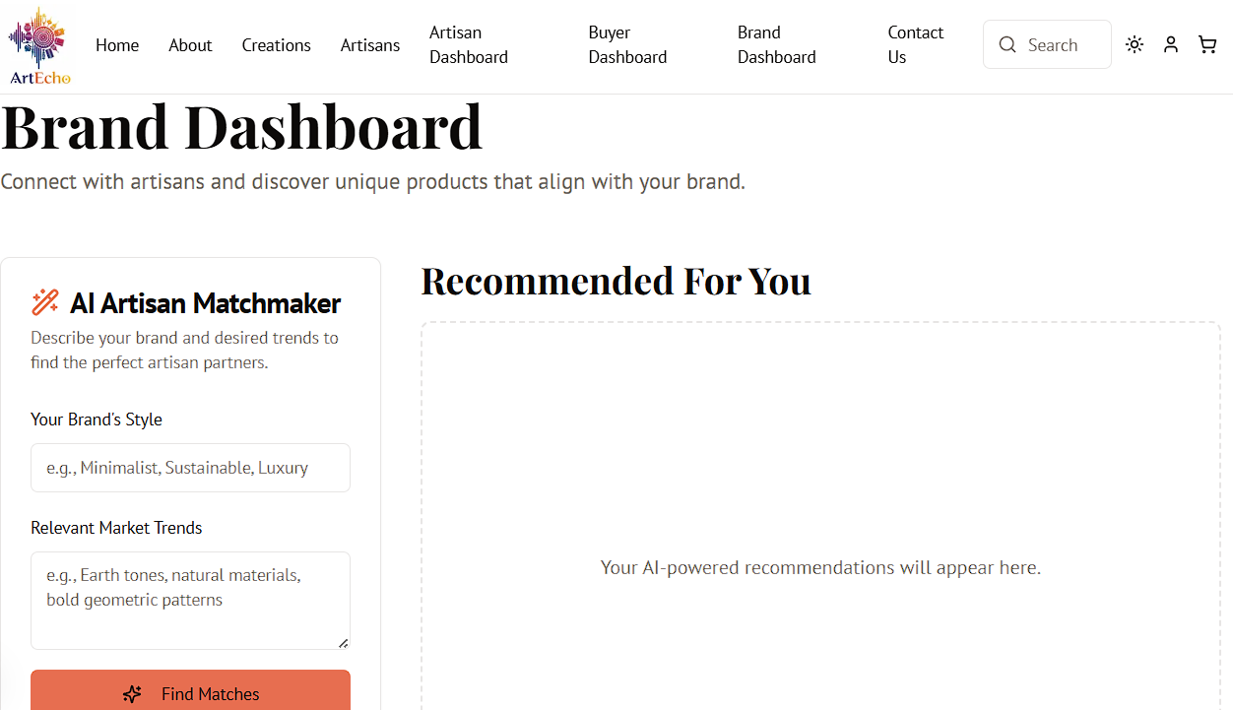

Slide 18
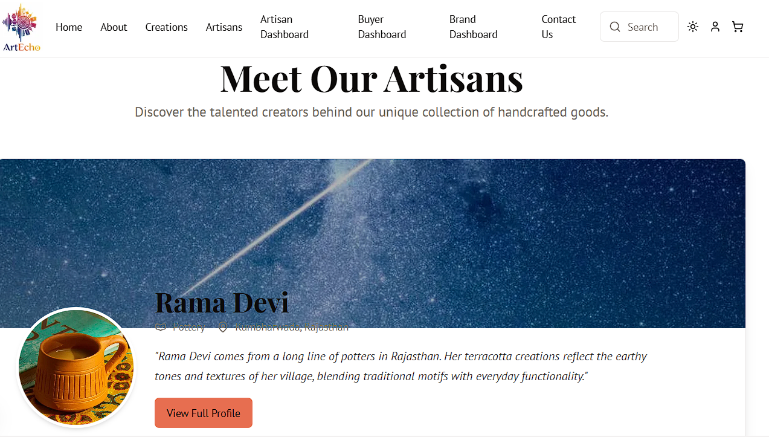

Slide 19
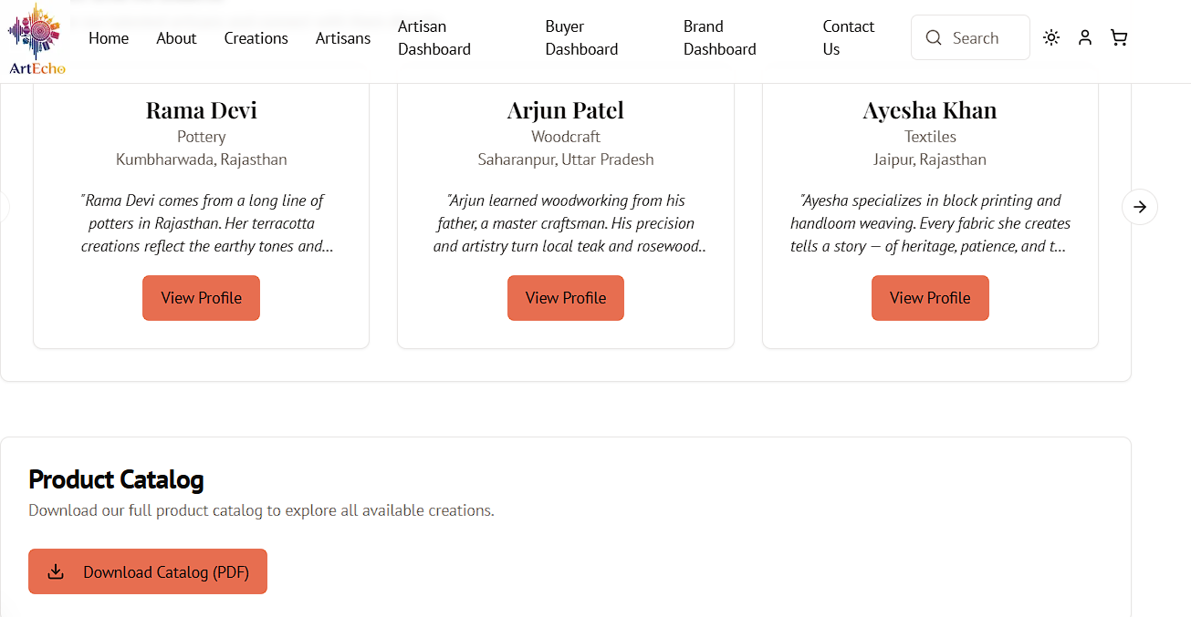

Slide 20
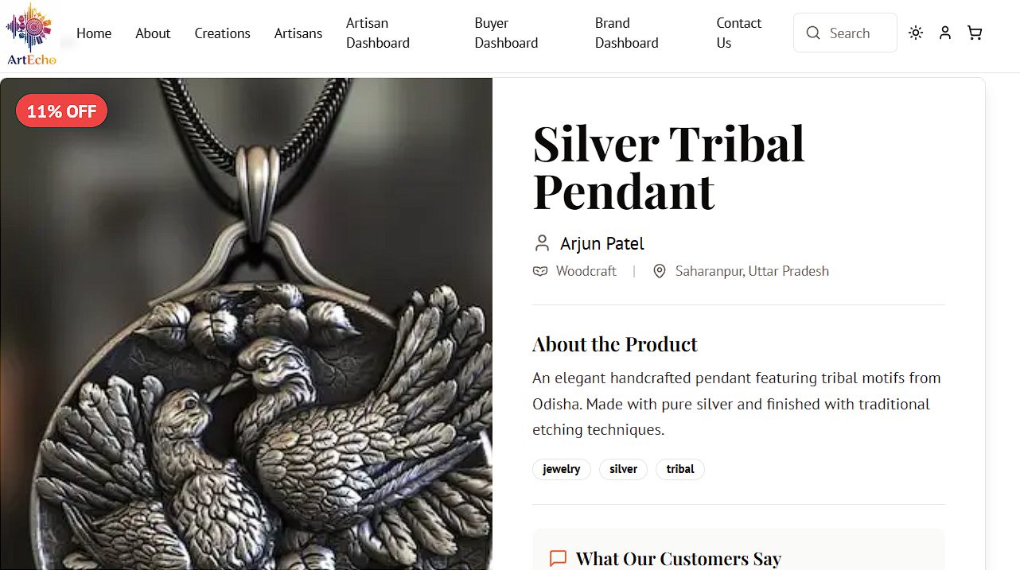
Ctose

Slide 21
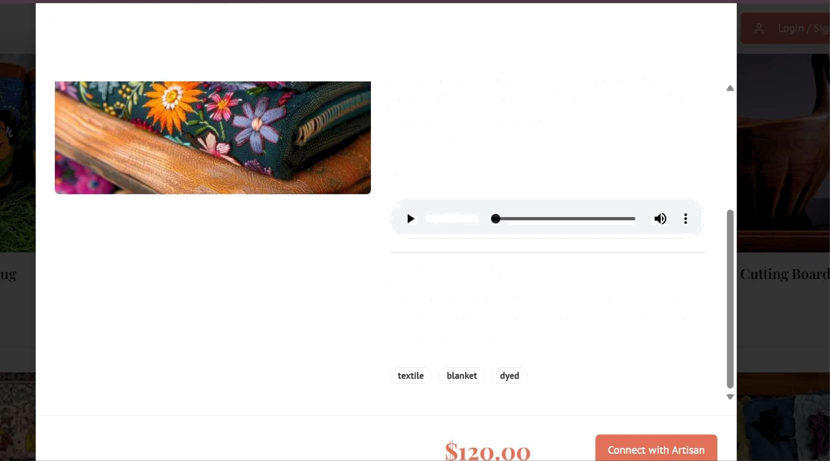
Indigo Shibori Blanket
,—, Amina Yusuf Textiles @ Marrakech, Morocco
of cultural fusion and skilled crajtsmanship. I•Iore than just a blanket, it's a piece of/•foroccon soul, a story woven in indigo and light, bringing artisanal charm and comfort to your home, handcrafted with passion by Amina and her cammunity.’
0 i Audio Story
0:00 / 0:50
Product Details
A beautiful hand-dyed blanket using the Japanese shibori technique with natural indigo. This soft cotton throw adds a touch of artisanal charm to any room.
Close

Slide 22
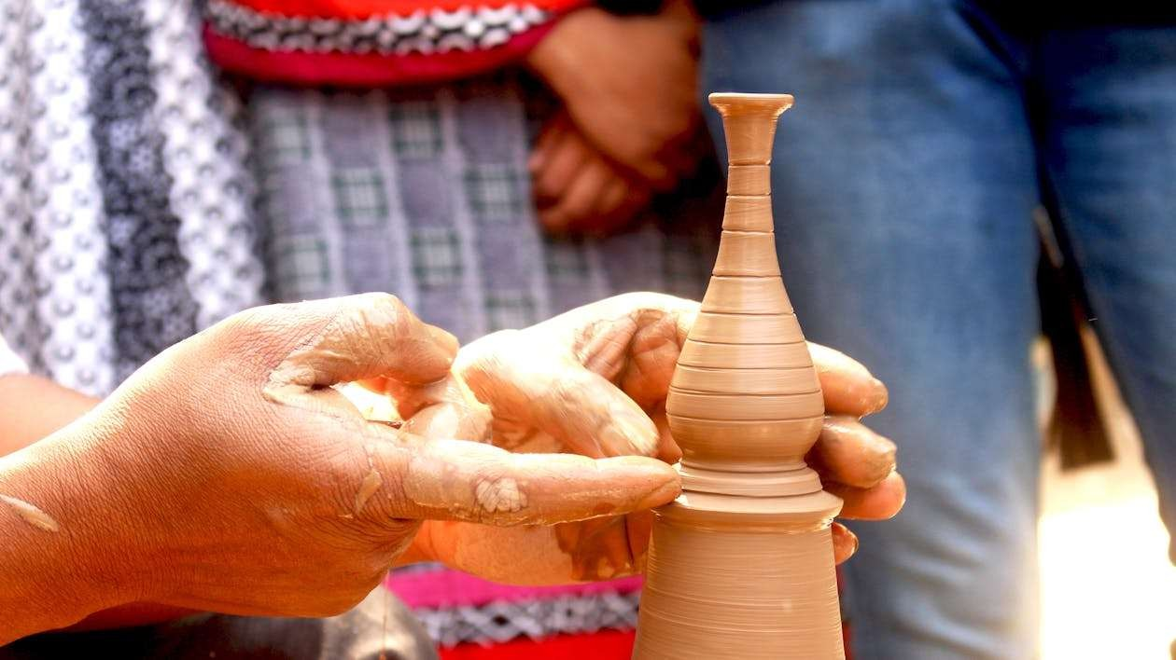
“ArtEcho is where tradition meets technology, empowering artisans to share their stories, showcase their craft, and connect with a world that values authenticity.”

Slide 23


